Slide 1
Reference Books
1) Systems Analysis and Design
Author: Elias M. Awad
2) Software Engineering, ^{6th} edition
Author: Lan Sommerville
3) Software Engineering
Author: Roger S. Pressman

Slide 2
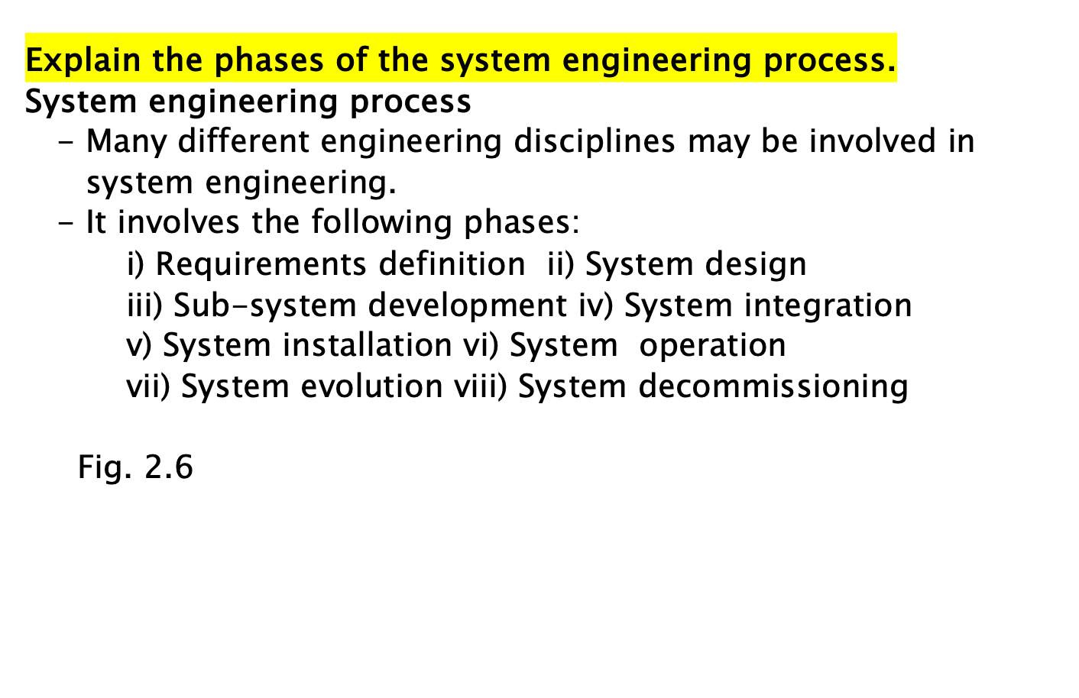

Slide 3
Information Desk
New Account Open
Cash Counter
Cheque Processing
Debit and Credit Services
FDR
Savings Certificates
Loan Service
Electronic Card Processing
IT Management
Electronic Banking
      ATM Card and ATM Booth
      Debit Card
      Credit Card

Slide 4
System Design
It is concerned with how the system functionality is to be provided by the different components of the system.
The following activities are involved:
    Partition requirements: The requirements are analyzed and collected into groups.
    Identify subsystems: Different sub-systems that can individually or collectively meet the requirements are identified.
    Assign requirements to sub-systems: The requirements are assigned to subsystems.
    Specify sub-system functionality: The specific functions provided by each subsystem are specified.
    Define sub-system interfaces: It defines the interfaces that are provided and required by each subsystem.
Fig. 2.8

Slide 5
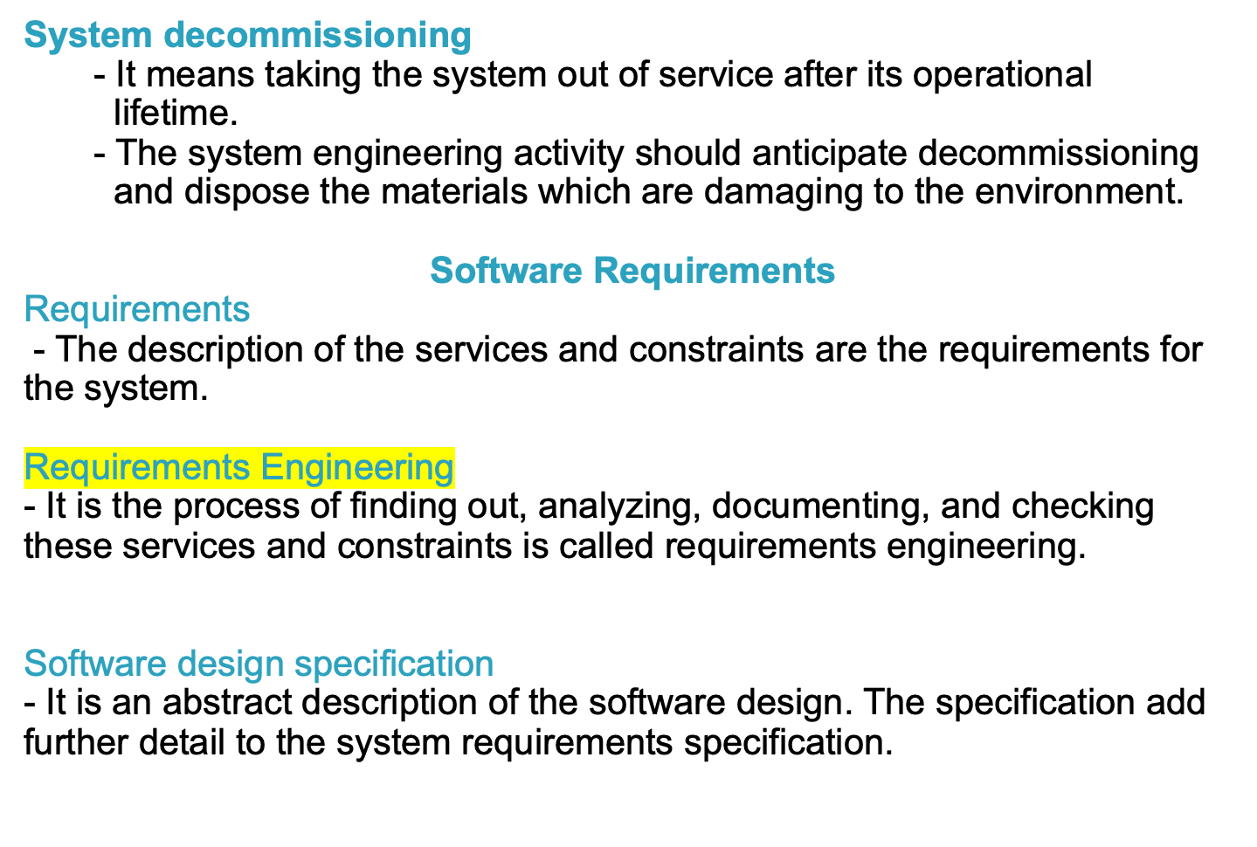

Slide 6
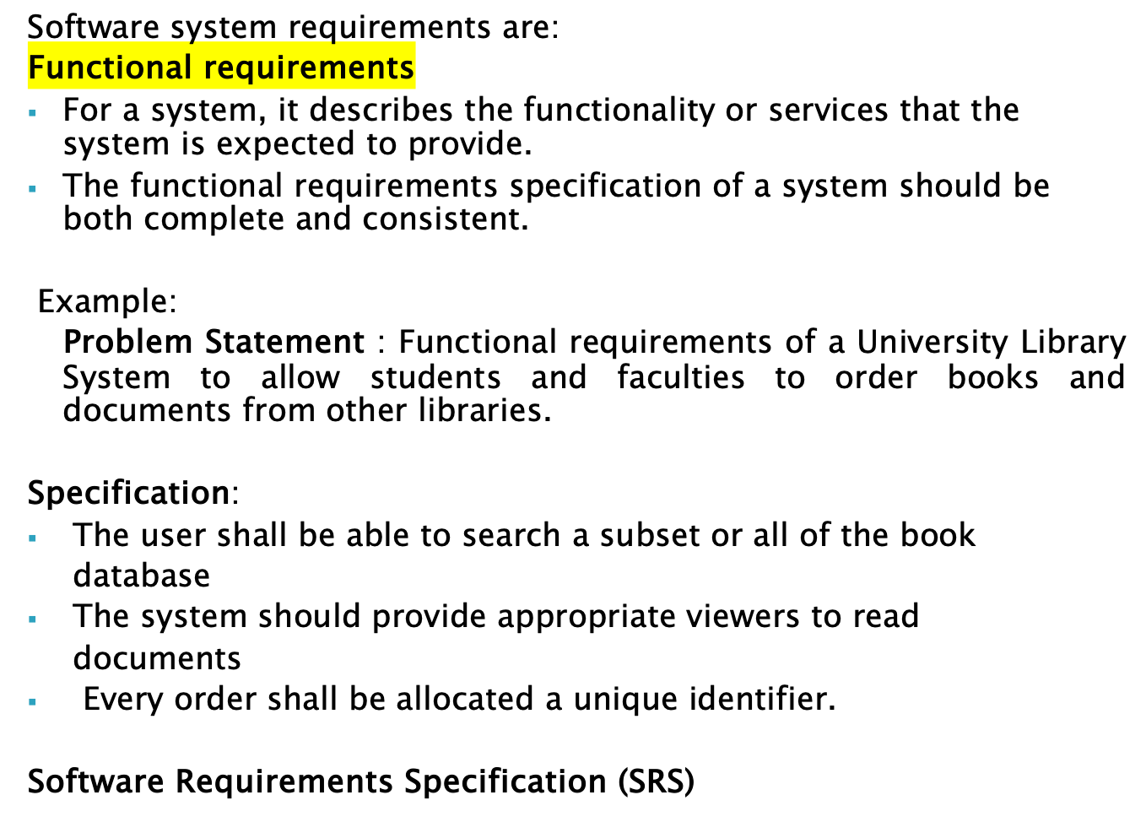

Slide 7
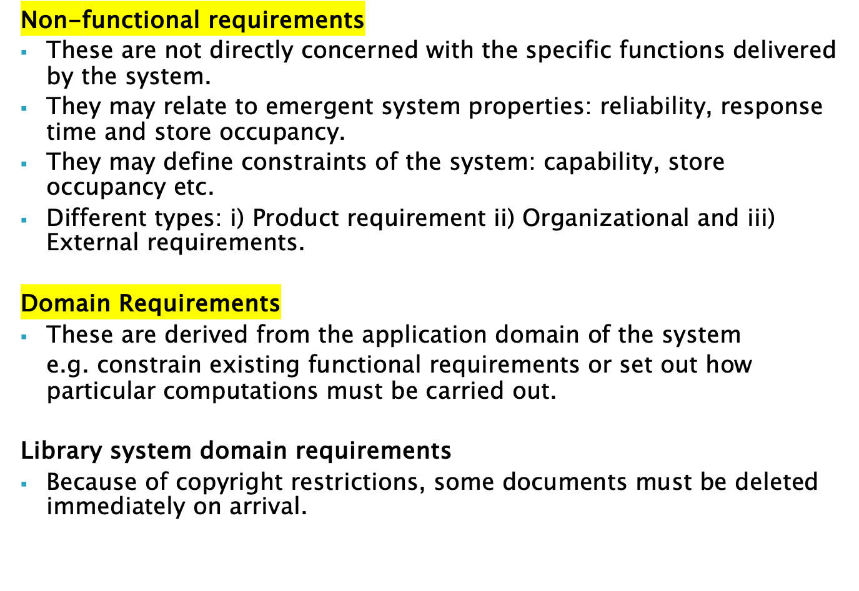

Slide 8
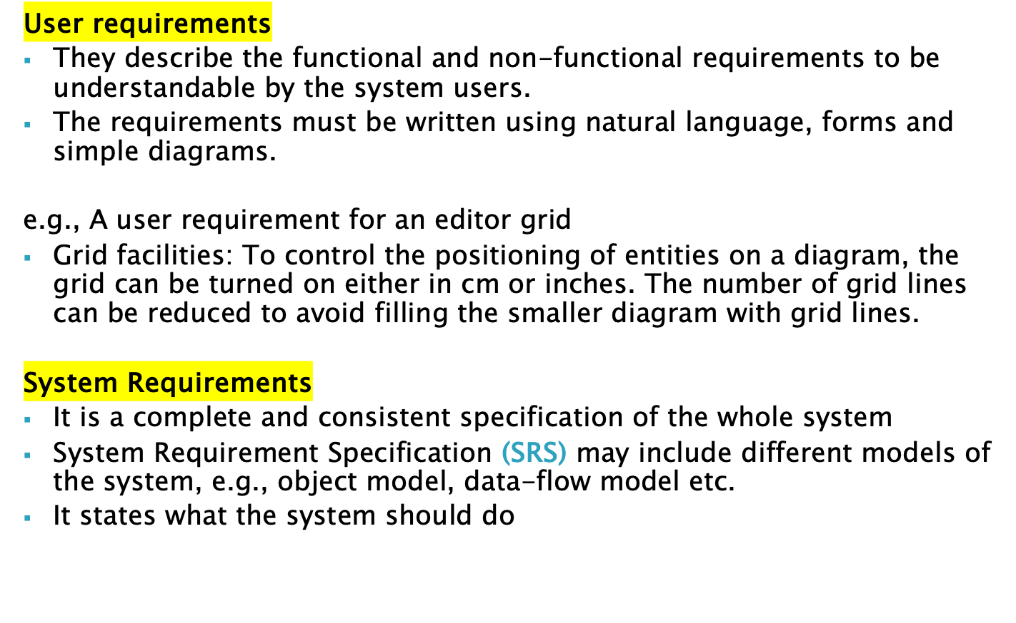

Slide 9
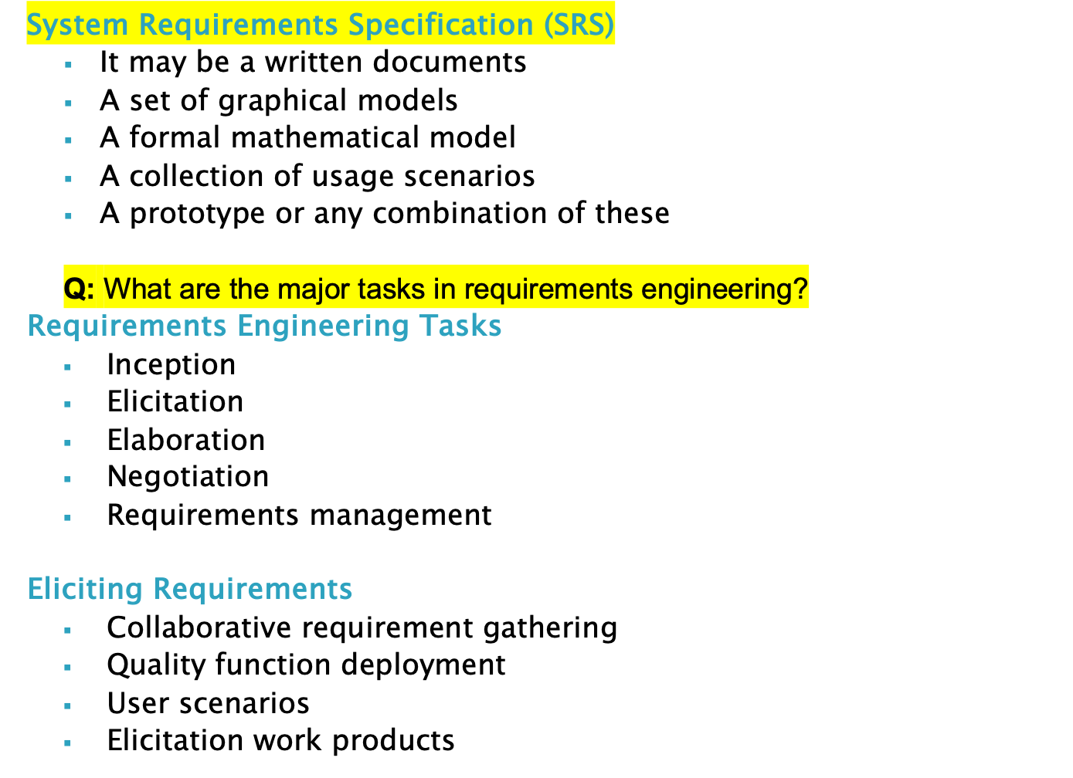
System Requirements Specification

Slide 10
Elicitation Work Products
Elicitation Work Products
The work products are produced as a consequence of requirements elicitation.
The work products include:
A statement of need and feasibility
Bounded statement of scope for the system or product
A list of customers, users, and stakeholders who participate in requirements elicitation
Description of the systems technical environment
List of requirements and domain constraints
A set of usage scenarios
Any prototype developed to define requirements

Slide 11
Software Requirements Analysis Process
Requirements Analysis Process
It results in the specification of software’s operational characteristics, indicates software’s interface with other system elements and establishes constraints that software must meet.
Allows to elaborate basic requirements, build models of user scenarios, functional activities, problem classes and their relationships, system and class behavior, and the flow of data.
Provides the software designer with a representation of information, function and behavior, that can be translated to architectural, interface, and component level designs.
Analyst should model what is known and use that model as the basis for design of the software.
Models of a System
Different types of models: i) analysis model ii) design model iii) construction model

Slide 12
Analysis Model
Objectives: i) Describes what the customer requires ii) establishes a basis for the creation of a software design iii) to define a set of requirements.
It bridges the gap between a system-level description and a software design.
See Fig. 8.1
All elements of the analysis model are directly traceable to parts of the design model. (Fig. 8.3)
Two types of analysis: i) domain analysis ii) application analysis
Domain Analysis (OO)
It is the identification, analysis, and specification of common, reusable capabilities within a specific application domain, in terms of common objects, classes, subassemblies, and frameworks.
Example domains: Banking, aircraft control system, video games etc.
See Fig. 8.2
Analysis Modeling Approaches
Two types: i) Structured analysis ii) Object-oriented (OO) analysis
See Fig. 8.3

Slide 13
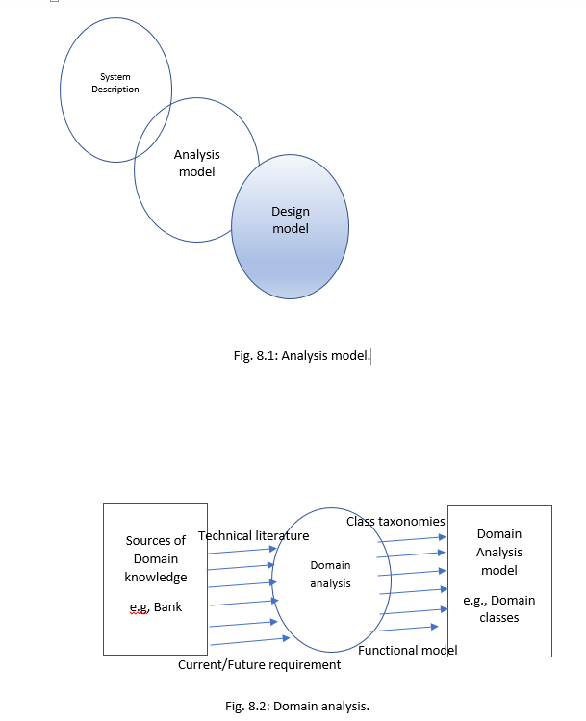

Slide 14
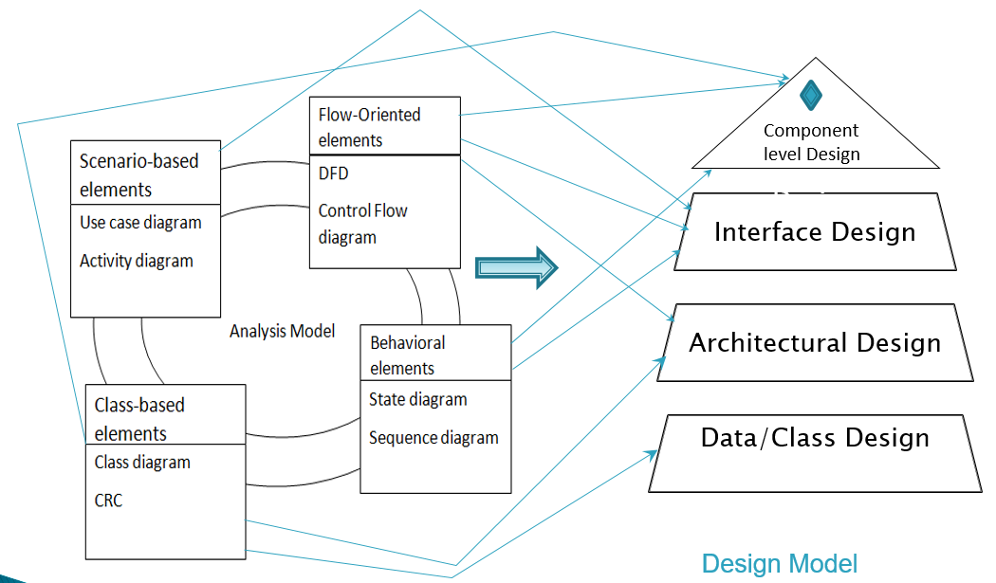
Fig. 8.3

Slide 15
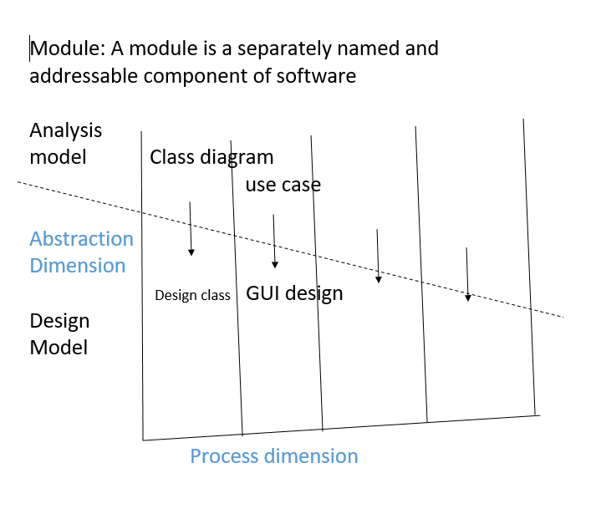

Slide 16
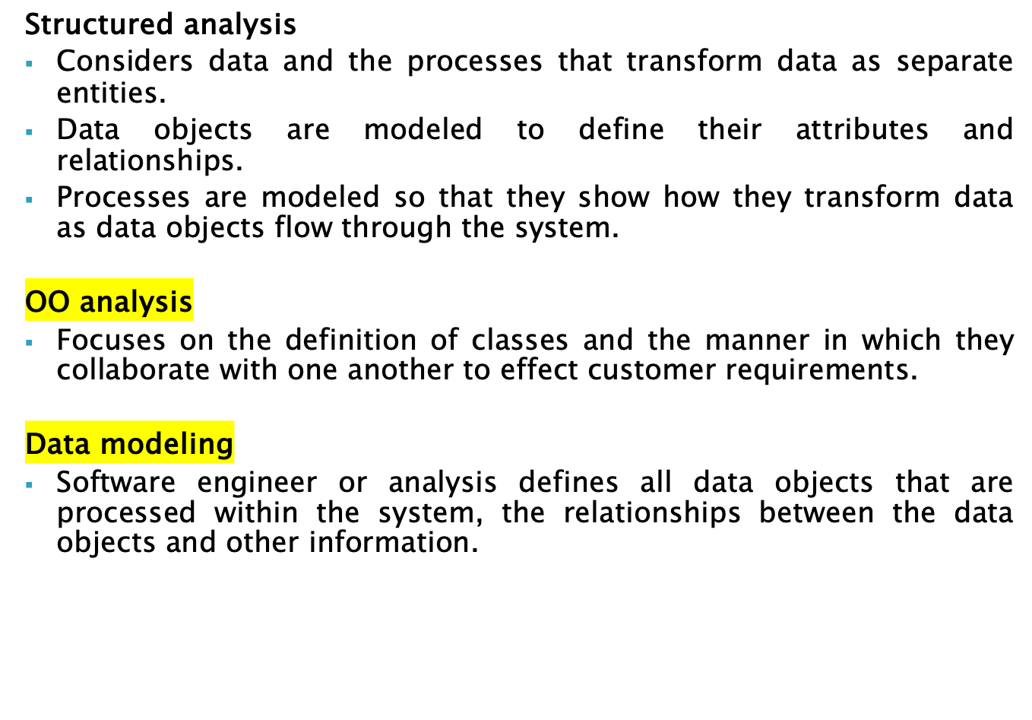

Slide 17
